Slide 1

AlienBreed Assets Design
By Hezron Calucag

Slide 2
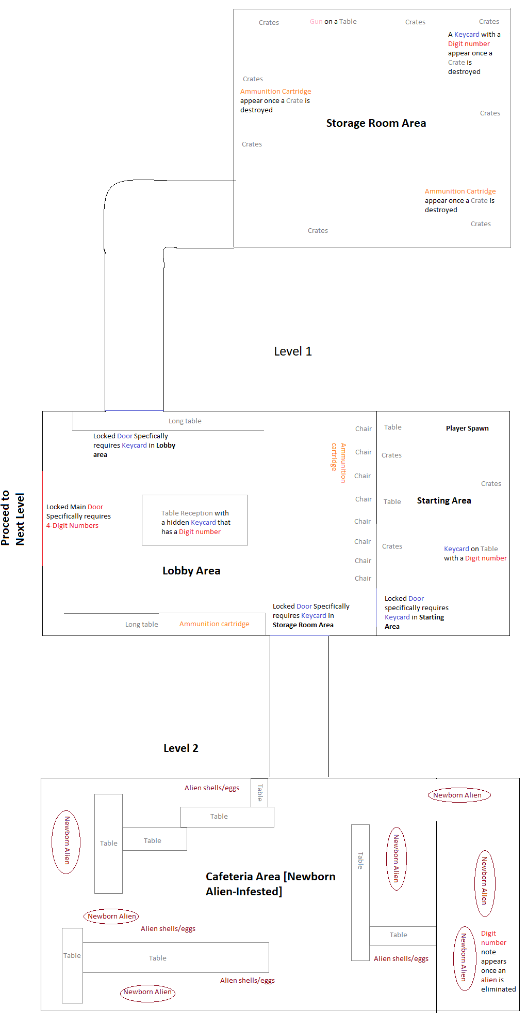
Conceptual Level Design
Level 1 area
Starting area
Lobby area
Storage room area
Level 2 area
Cafeteria Area [Newborn Alien-Infested]

Slide 3
The Design Process
The Main Character
Scenery Objects
Texture (Some designed by me)
Audios

Slide 4
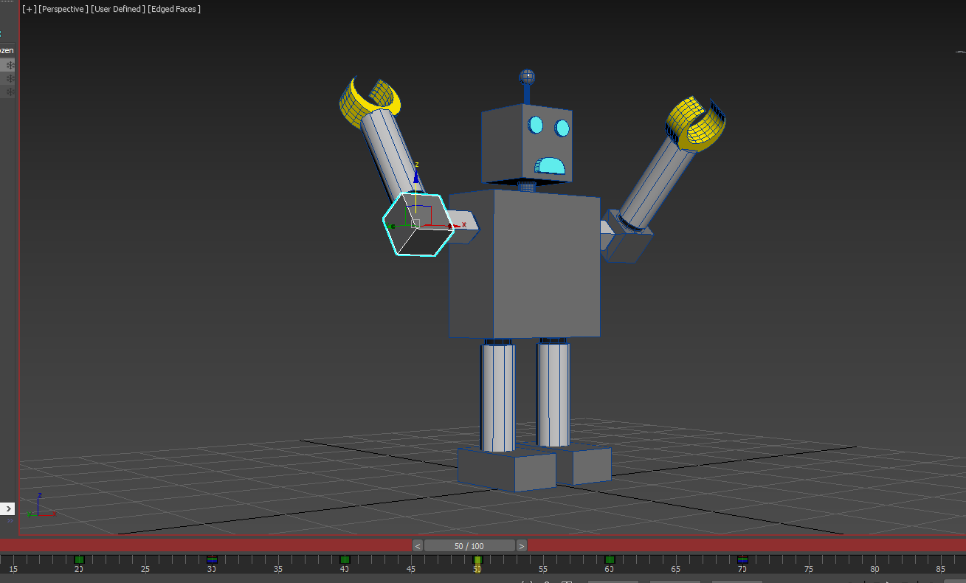
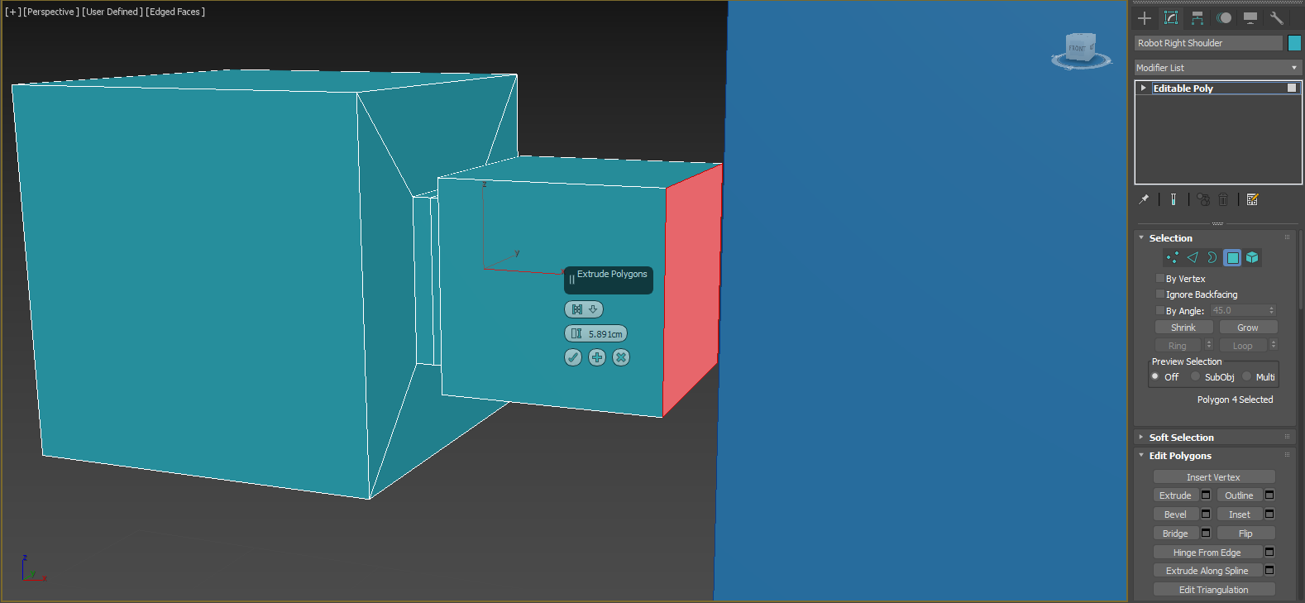
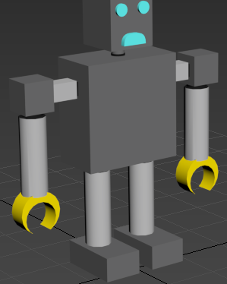
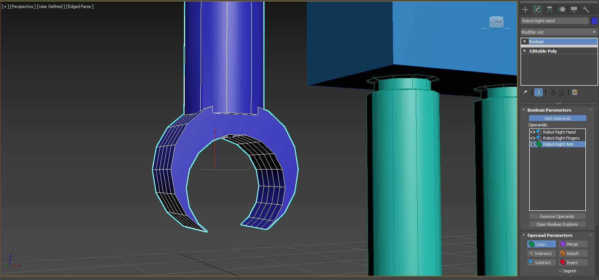
Character- Tools & Techniques Used
Standard Primitive – Box (Move and Rescale tool used)
Inset, Bevel and Extrude tools
Chamfer
Boolean – Subtract and Union
Material Editor
Simple keyframe animation

Slide 5
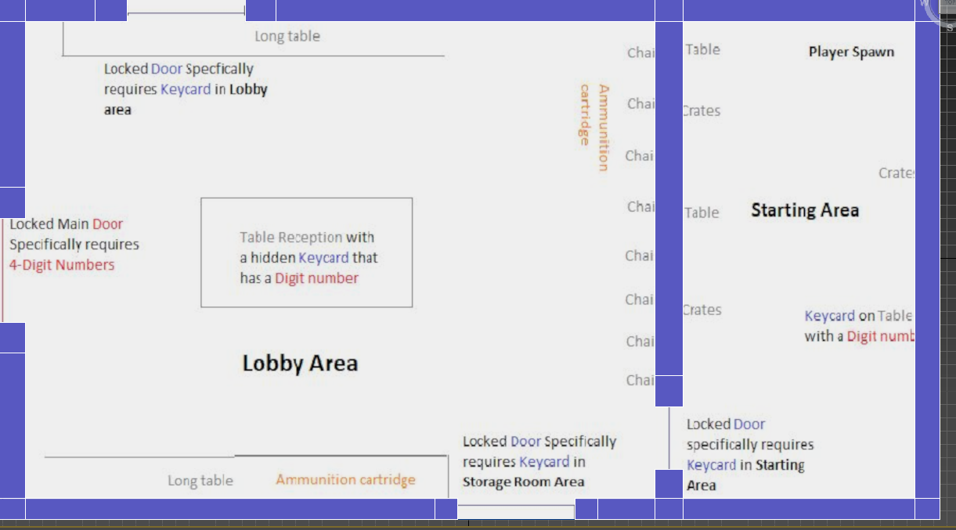
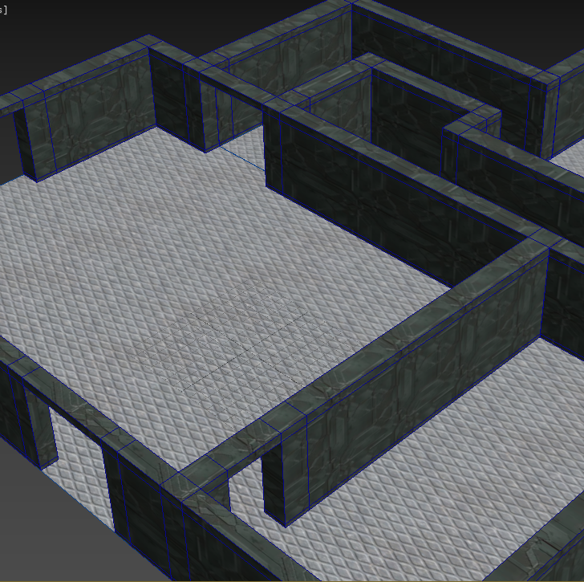
Level - Tools & Techniques Used
Standard Primitives – Plane
Extrude and Bridge tools
UVW Map - Gizmo

Slide 6
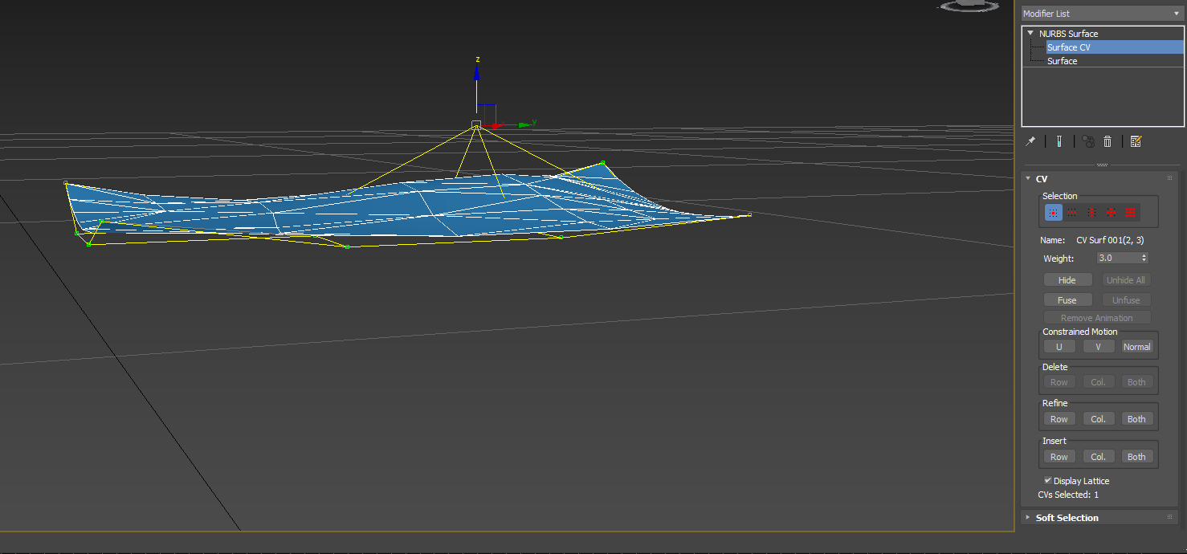
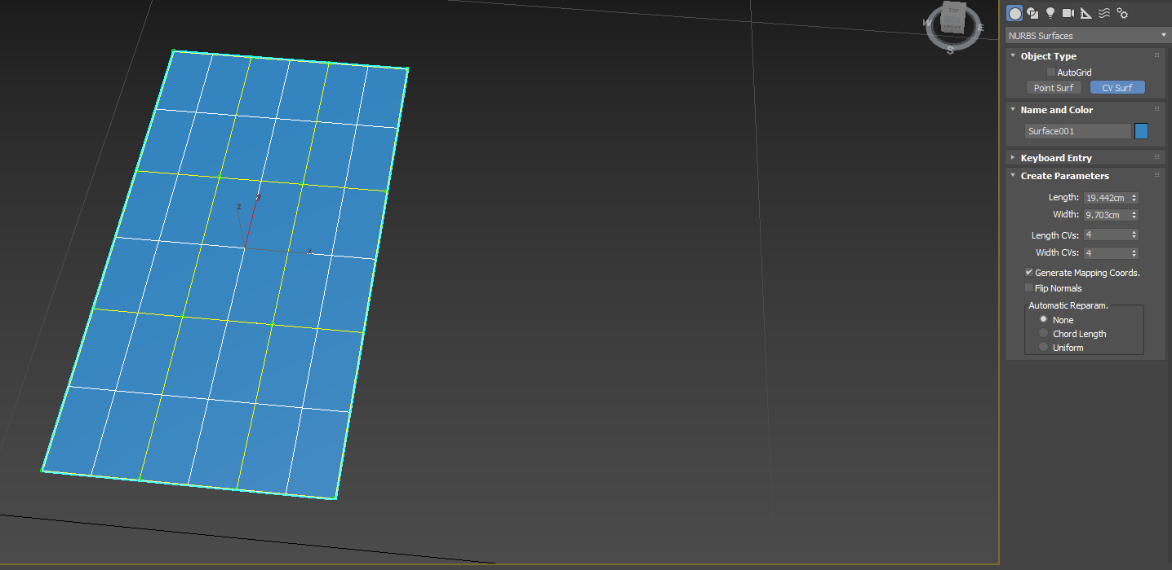
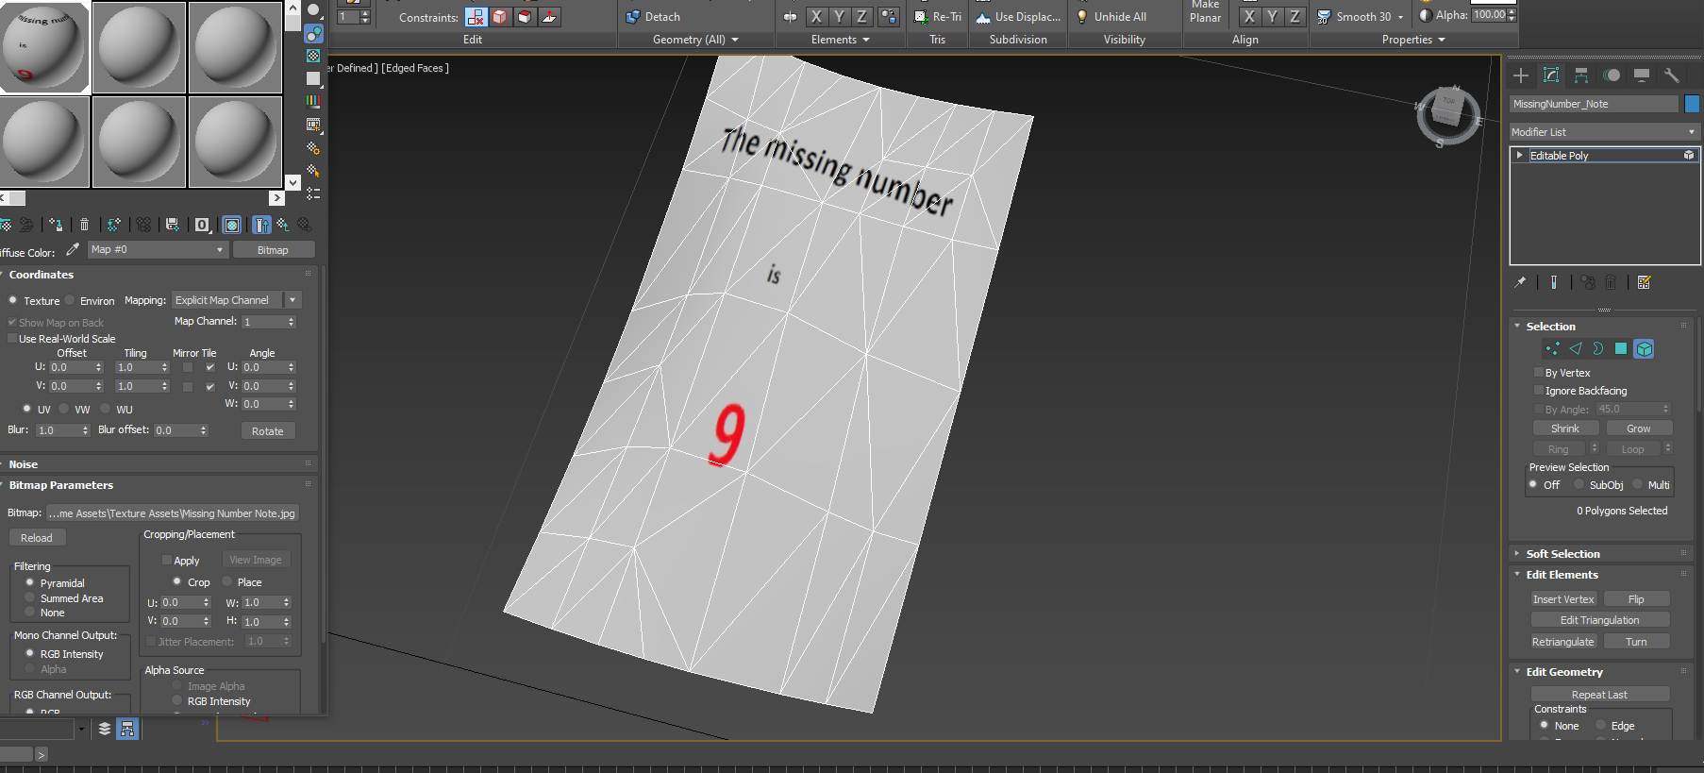
Objects – Tools & Techniques Used
NURBS – Surface CV tool
Material Editor – imported texture

Slide 7
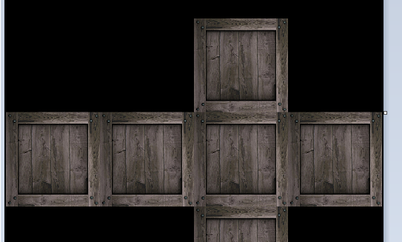
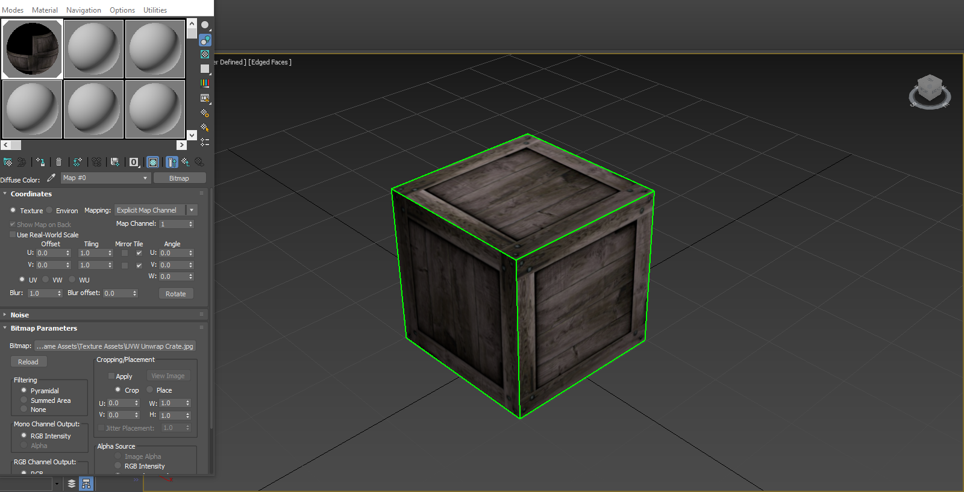
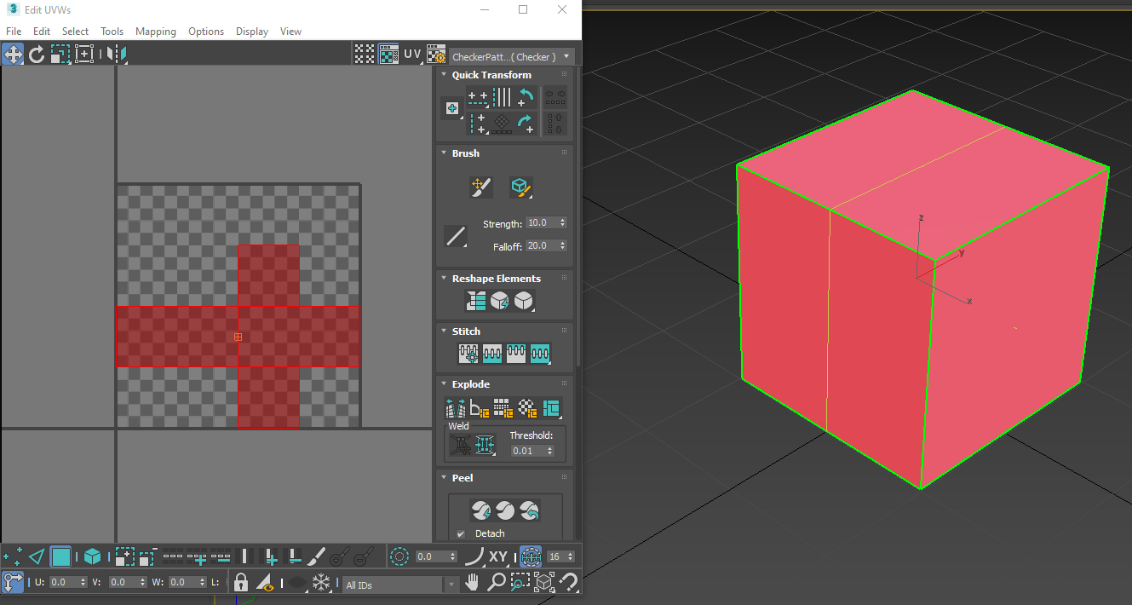
Objects – Tools & Techniques Used
UVW Unwrap

Slide 8
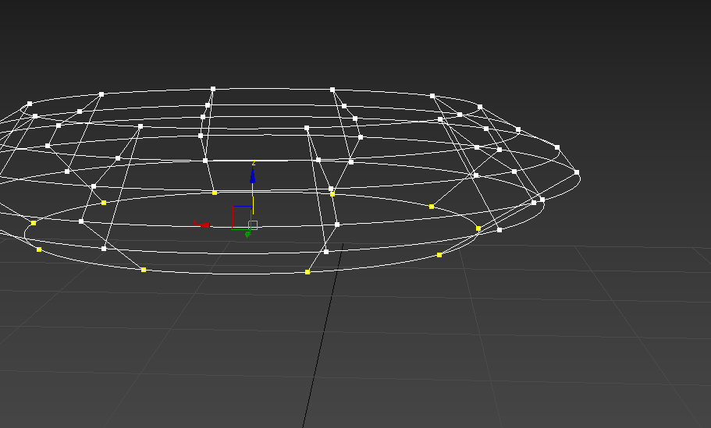
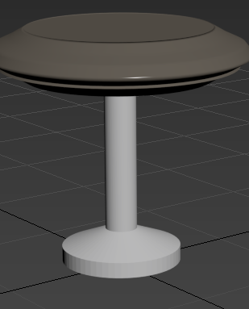
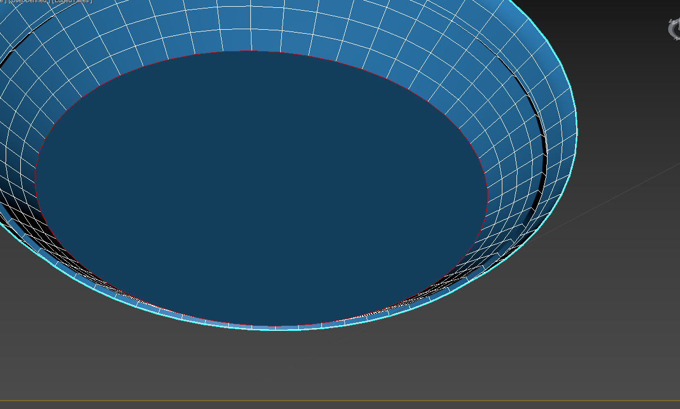
Objects – Tools & Technique Used
Splines – Circular
Cross Section Modifier
Surface Modifier
Cap Holes

Slide 9
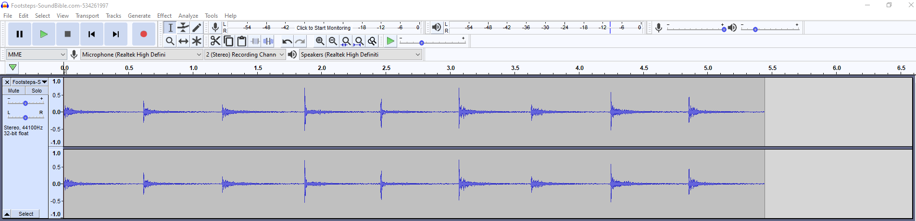
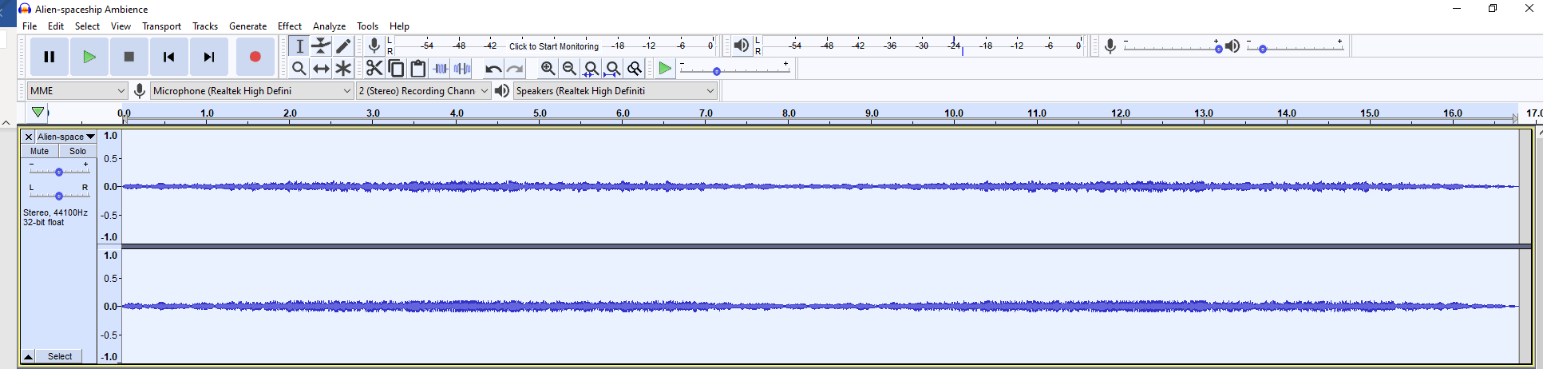
Audio – Tools & Techniques Used
Change Tempo
Amplify – decrease volume

Slide 10
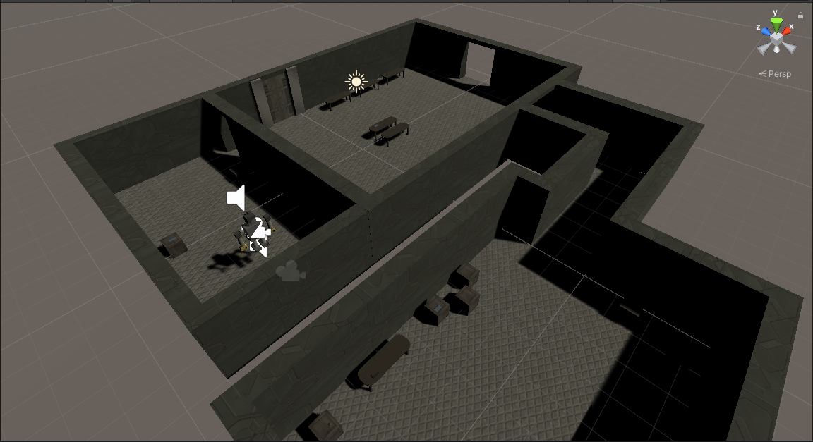
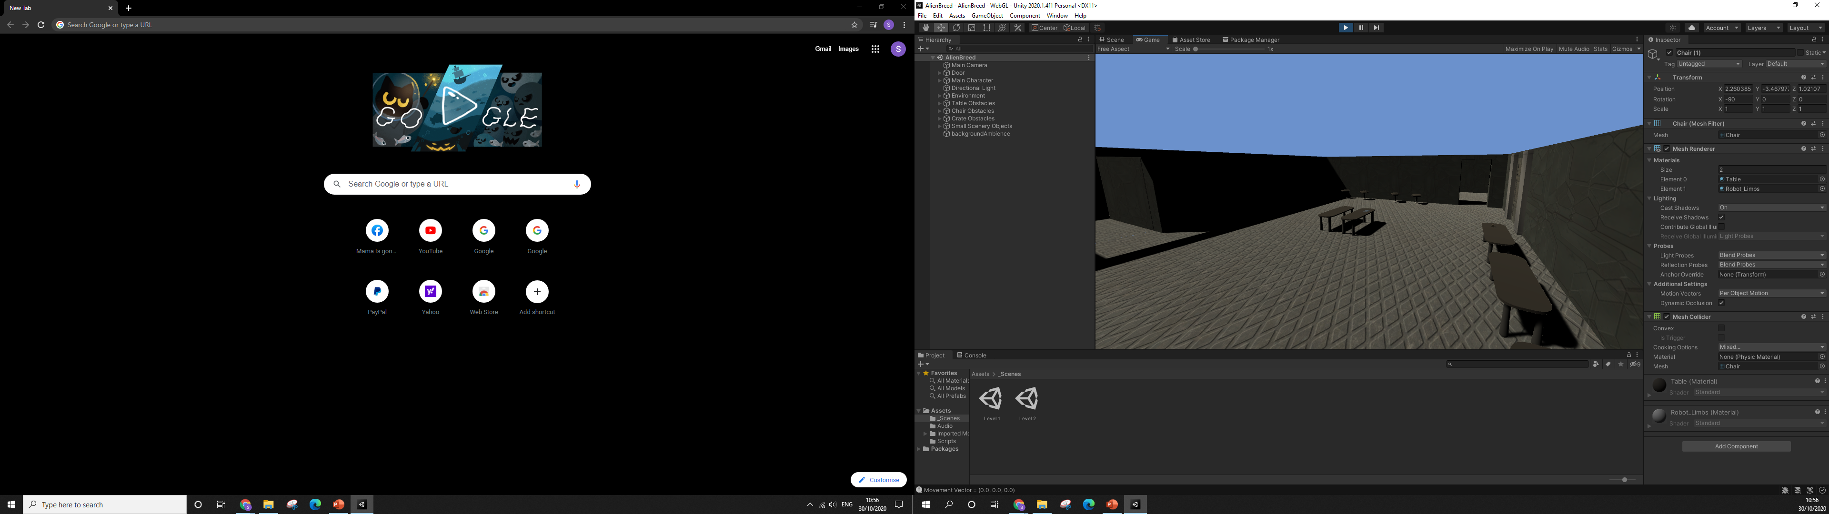
Implementation

